Slide 1

VIETNAM NATIONAL UNIVERSITY – HO CHI MINH CITY
UNIVERSITY OF INFORMATION TECHNOLOGY
DS307
SOCIAL MEDIA ANALYSIS
Faculty of Information Science and Engineering
University of Information Technology, VNU-HCM
UIT, VNU-HCM
Social Media Analysis

Slide 2
This course’s contents
  Evaluation of IR
UIT, VNU-HCM
Social Media Analysis

Slide 3
This course’s contents
How good are the returned documents?
UIT, VNU-HCM
Social Media Analysis

Slide 4
Measures for a search engine
How fast does it index?
UIT, VNU-HCM
Social Media Analysis

Slide 5
Measures for a search engine
How fast does it index?
  e.g., number of bytes per hour
UIT, VNU-HCM
Social Media Analysis

Slide 6
Measures for a search engine
How fast does it index?
  e.g., number of bytes per hour
How fast does it search?
UIT, VNU-HCM
Social Media Analysis

Slide 7
Measures for a search engine
How fast does it index?
  e.g., number of bytes per hour
How fast does it search?
  e.g., latency as a function of queries per second
UIT, VNU-HCM
Social Media Analysis

Slide 8
Measures for a search engine
How fast does it index?
  e.g., number of bytes per hour
How fast does it search?
  e.g., latency as a function of queries per second
What is the cost per query?
UIT, VNU-HCM
Social Media Analysis

Slide 9
Measures for a search engine
How fast does it index?
  e.g., number of bytes per hour
How fast does it search?
  e.g., latency as a function of queries per second
What is the cost per query?
  in dollars
UIT, VNU-HCM
Social Media Analysis

Slide 10
Measures for a search engine
All of the preceding criteria are measurable: we can quantify speed / size / money
UIT, VNU-HCM
Social Media Analysis

Slide 11
Measures for a search engine
All of the preceding criteria are measurable: we can quantify speed / size / money
However, the key measure for a search engine is user happiness.
UIT, VNU-HCM
Social Media Analysis

Slide 12
Measures for a search engine
All of the preceding criteria are measurable: we can quantify speed / size / money
However, the key measure for a search engine is user happiness.
What is user happiness?
UIT, VNU-HCM
Social Media Analysis

Slide 13
Measures for a search engine
All of the preceding criteria are measurable: we can quantify speed / size / money
However, the key measure for a search engine is user happiness.
What is user happiness?
Factors include:
UIT, VNU-HCM
Social Media Analysis

Slide 14
Measures for a search engine
All of the preceding criteria are measurable: we can quantify speed / size / money
However, the key measure for a search engine is user happiness.
What is user happiness?
Factors include:
  Speed of response
  Size of index
  Uncluttered UI
  We can measure
    Rate of return to this search engine
    Whether something was bought
    Whether ads were clicked
  Most important: relevance
UIT, VNU-HCM
Social Media Analysis

Slide 15
Measures for a search engine
All of the preceding criteria are measurable: we can quantify speed / size / money
However, the key measure for a search engine is user happiness.
What is user happiness?
Factors include:
  Speed of response
  Size of index
  Uncluttered UI
  We can measure
    Rate of return to this search engine
    Whether something was bought
    Whether ads were clicked
  Most important: relevance
UIT, VNU-HCM
Social Media Analysis

Slide 16
Measures for a search engine
All of the preceding criteria are measurable: we can quantify speed / size / money
However, the key measure for a search engine is user happiness.
What is user happiness?
Factors include:
  Speed of response
  Size of index
  Uncluttered UI
  We can measure
    Rate of return to this search engine
    Whether something was bought
    Whether ads were clicked
  Most important: relevance
  (actually, maybe even more important: it’s free)
UIT, VNU-HCM
Social Media Analysis
Notes:
Note that none of these is sufficient: blindingly fast, but useless answers won’t make a user happy.

Slide 17
Most common definition of user happiness: Relevance
User happiness is equated with the relevance of search results to the query.
But how do you measure relevance?
Standard methodology in information retrieval consists of three elements
  Benchmark document collection
  A benchmark suite of queries
  An assessment of the relevance of each query-document pair
UIT, VNU-HCM
Social Media Analysis
Notes:
Note that none of these is sufficient: blindingly fast, but useless answers won’t make a user happy.

Slide 18
Relevance: query vs. information need
Relevance to what? The query?
  Information need i: “I am looking for information on whether drinking red wine is more effective at reducing your risk of heart attacks than white wine.”
Translated into:
  Query q: [red wine white wine heart attack]
So what about the following document:
  Document d′: At the heart of his speech was an attack on the wine industry lobby for downplaying the role of red and white wine in drunk driving.
UIT, VNU-HCM
Social Media Analysis
Notes:
Note that none of these is sufficient: blindingly fast, but useless answers won’t make a user happy.

Slide 19
Relevance: query vs. information need
User happiness can only be measured by relevance to an information need, not by relevance to queries.
Sloppy terminology here and elsewhere in the literature: we talk about query–document relevance judgments even though we mean information-need–document relevance judgments.
UIT, VNU-HCM
Social Media Analysis
Notes:
Note that none of these is sufficient: blindingly fast, but useless answers won’t make a user happy.

Slide 20
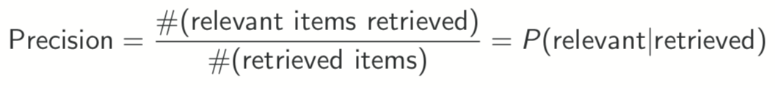
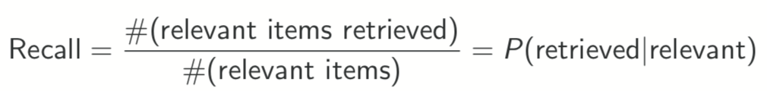
Relevance: query vs. information need
Precision (P) is the fraction of retrieved documents that are relevant:
Recall (R) is the fraction of relevant documents that are retrieved:
UIT, VNU-HCM
Social Media Analysis
Notes:
Note that none of these is sufficient: blindingly fast, but useless answers won’t make a user happy.

Slide 21
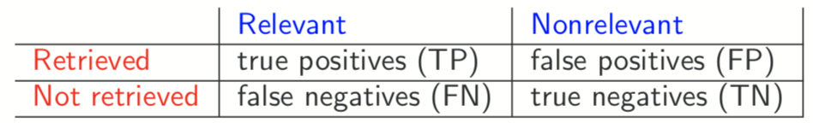
Relevance: query vs. information need
UIT, VNU-HCM
Social Media Analysis
Notes:
Note that none of these is sufficient: blindingly fast, but useless answers won’t make a user happy.

Slide 22
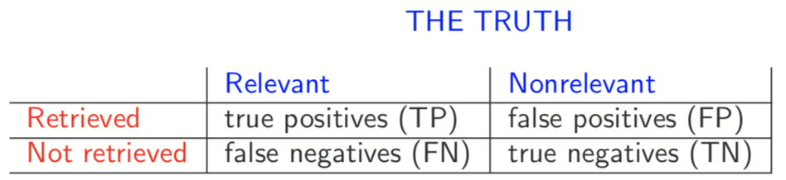
Relevance: query vs. information need
UIT, VNU-HCM
Social Media Analysis
Notes:
Note that none of these is sufficient: blindingly fast, but useless answers won’t make a user happy.

Slide 23
Relevance: query vs. information need
UIT, VNU-HCM
Social Media Analysis
Notes:
Note that none of these is sufficient: blindingly fast, but useless answers won’t make a user happy.

Slide 24
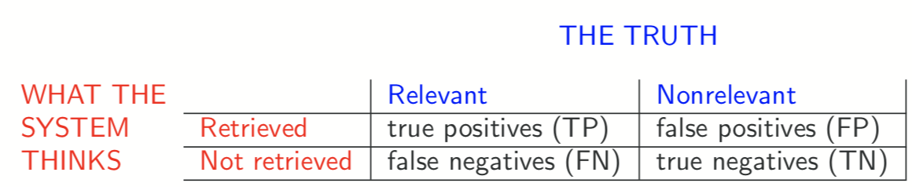
Relevance: query vs. information need
UIT, VNU-HCM
Social Media Analysis
Notes:
Note that none of these is sufficient: blindingly fast, but useless answers won’t make a user happy.

Slide 25
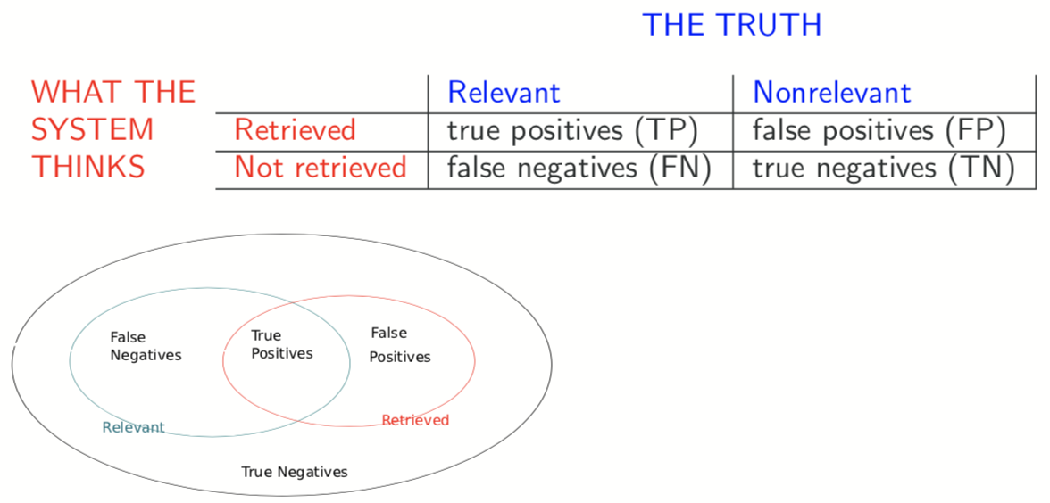
Relevance: query vs. information need
UIT, VNU-HCM
Social Media Analysis
Notes:
Note that none of these is sufficient: blindingly fast, but useless answers won’t make a user happy.

Slide 26
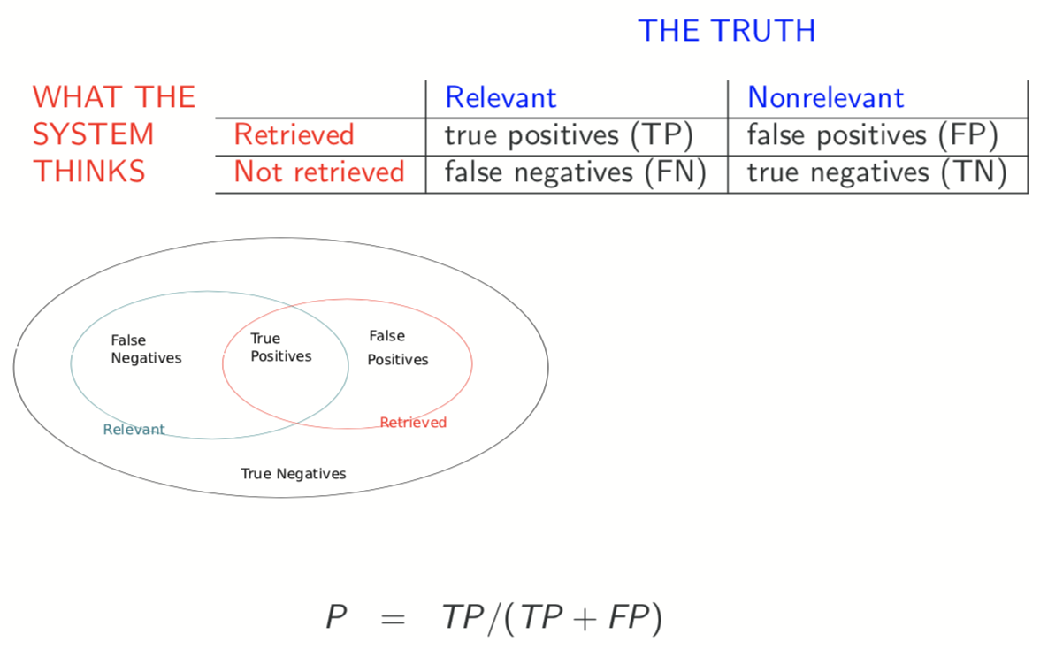
Relevance: query vs. information need
UIT, VNU-HCM
Social Media Analysis
Notes:
Note that none of these is sufficient: blindingly fast, but useless answers won’t make a user happy.

Slide 27
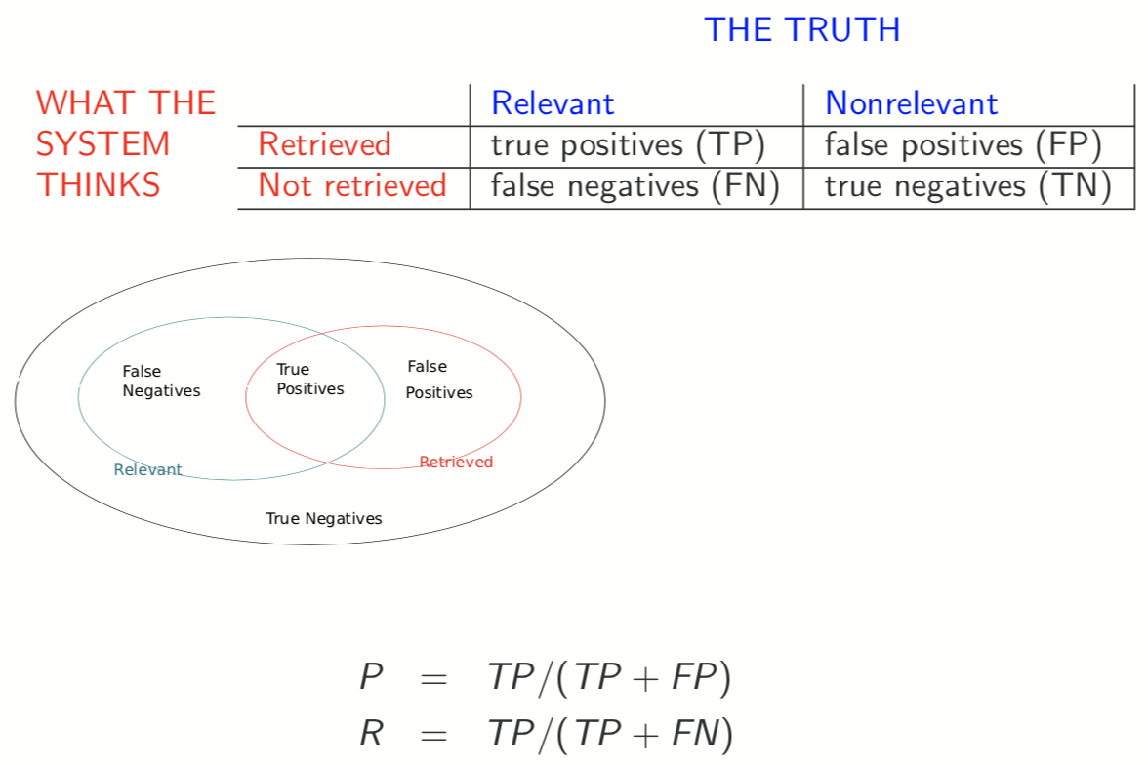
Relevance: query vs. information need
UIT, VNU-HCM
Social Media Analysis
Notes:
Note that none of these is sufficient: blindingly fast, but useless answers won’t make a user happy.

Slide 28
Precision/Recall Trade-off
You can increase recall by returning more docs.
Recall is a non-decreasing function of the number of docs retrieved.
A system that returns all docs has 100% recall!
The converse is also true (usually): It’s easy to get high precision for very low recall.
UIT, VNU-HCM
Social Media Analysis
Notes:
Note that none of these is sufficient: blindingly fast, but useless answers won’t make a user happy.

Slide 29
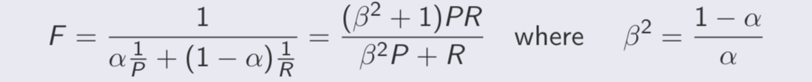
A combined measure: F
F allows us to trade off precision against recall
α ∈ [0,1] and thus β2 ∈ [0,∞]
Most frequently used: balanced F with β = 1 or α = 0.5
This is the harmonic mean of P and R: 1/F = ½.(1/P + 1/R)
UIT, VNU-HCM
Social Media Analysis
Notes:
Note that none of these is sufficient: blindingly fast, but useless answers won’t make a user happy.

Slide 30
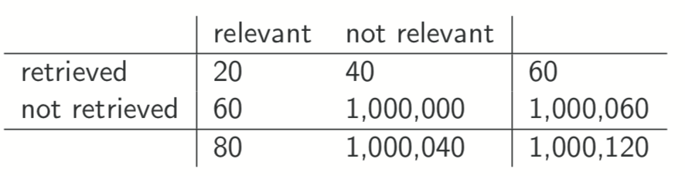
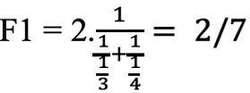
Example for precision, recall and F1
P =20/(20+40)=1/3
R =20/(20+60)=1/4
UIT, VNU-HCM
Social Media Analysis
Notes:
Note that none of these is sufficient: blindingly fast, but useless answers won’t make a user happy.

Slide 31
Accuracy
Why do we use complex measures like precision, recall, and F ?
UIT, VNU-HCM
Social Media Analysis
Notes:
Note that none of these is sufficient: blindingly fast, but useless answers won’t make a user happy.

Slide 32
Accuracy
Why do we use complex measures like precision, recall, and F ?
Why not something simple like accuracy?
Accuracy is the fraction of decisions (relevant/nonrelevant) that are correct.
In terms of the contingency table above, accuracy = (TP + TN)/(TP + FP + FN + TN).
UIT, VNU-HCM
Social Media Analysis
Notes:
Note that none of these is sufficient: blindingly fast, but useless answers won’t make a user happy.

Slide 33
Accuracy
Why do we use complex measures like precision, recall, and F ?
Why not something simple like accuracy?
Accuracy is the fraction of decisions (relevant/nonrelevant) that are correct.
In terms of the contingency table above, accuracy = (TP + TN)/(TP + FP + FN + TN).
UIT, VNU-HCM
Social Media Analysis
Notes:
Note that none of these is sufficient: blindingly fast, but useless answers won’t make a user happy.

Slide 34
Though experiment
Computing precision, recall and F1-score for this result set:
You then get 99.99% accuracy on most queries.
 | relevant | not relevant
retrieved | 18 | 2
not retrieved | 82 | 1,000,000
UIT, VNU-HCM
Social Media Analysis
Notes:
Note that none of these is sufficient: blindingly fast, but useless answers won’t make a user happy.

Slide 35
Rank-Based Measures
Binary relevance
  Precision@K (P@K)
  Mean Average Precision (MAP)
  Mean Reciprocal Rank (MRR)
Multiple levels of relevance
  Normalized Discounted Cumulative Gain (NDCG)
UIT, VNU-HCM
Social Media Analysis

Slide 36

Precision@K
Set a rank threshold K
Compute % relevant in top K
Ignores documents ranked lower than K
Ex:
  Prec@3 of 2/3
  Prec@4 of 2/4
  Prec@5 of 3/5
In similar fashion we have Recall@K
UIT, VNU-HCM
Social Media Analysis

Slide 37

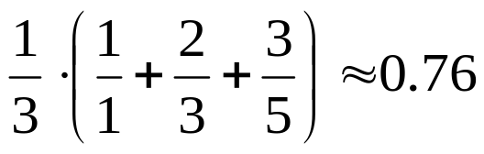
Mean Average Precision
Consider rank position of each relevant doc
  K₁, K₂, … K_{R}
Compute Precision@K for each K₁, K₂, … K_{R}
Average precision = average of P@K
Ex: has AvgPrec of
MAP is Average Precision across multiple queries/rankings
UIT, VNU-HCM
Social Media Analysis

Slide 38
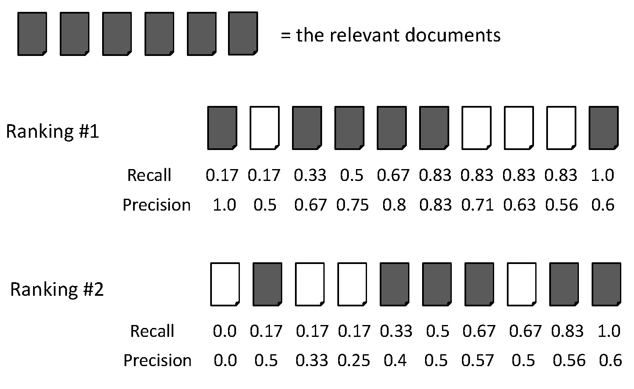
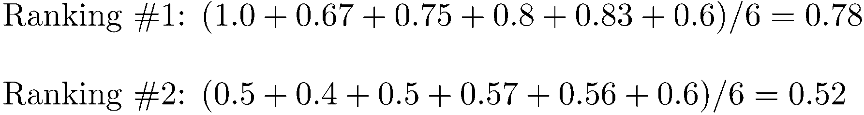
Average Precision
UIT, VNU-HCM
Social Media Analysis

Slide 39
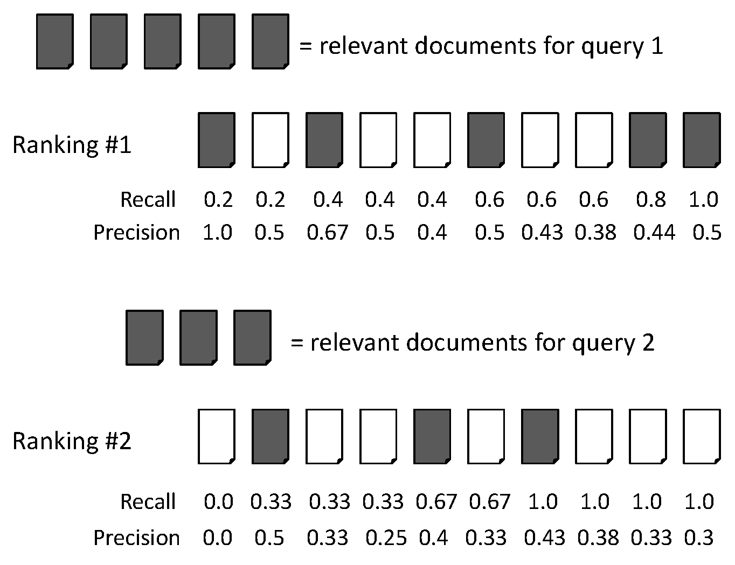
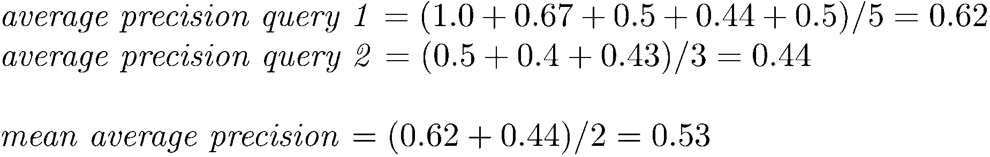
MAP
UIT, VNU-HCM
Social Media Analysis

Slide 40
Q&A
UIT, VNU-HCM
Social Media Analysis

Slide 41
  Thank you!
UIT, VNU-HCM
Social Media Analysis

